Slide 1

The Blaugranes
Anirudh, Gift, Kyle, Ufuoma

Slide 2

University of Regina
STUDENT HUB
MILESTONE 4

Slide 3
WHY?
Students at UofR are still strangers to each other and most of them don’t know what’s happening at University.
WHAT?
HOW?
HOW?
We aim to bring them together into one space where every student can connect with other student and explore the UofR life.
WHY?
WHAT?
An exclusive website service only for UofR students where they can start conversation, express their opinion, connect with other students and explore UofR

Slide 4

About Project
Social Networking website for students of University of Regina
STUDENT
Know what's happening at UofR
HUB
Join the conversation and express your opinion

Slide 5
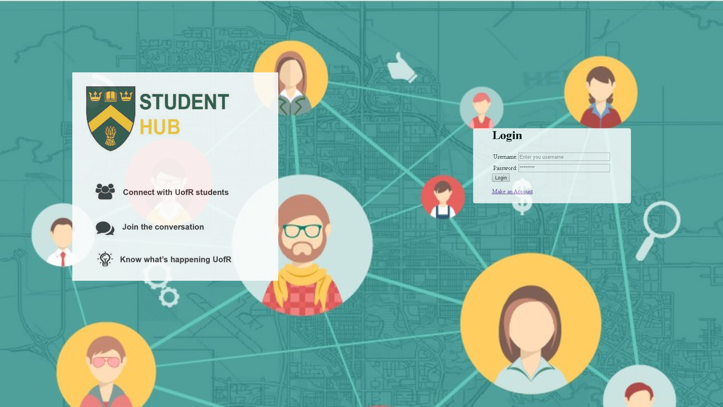
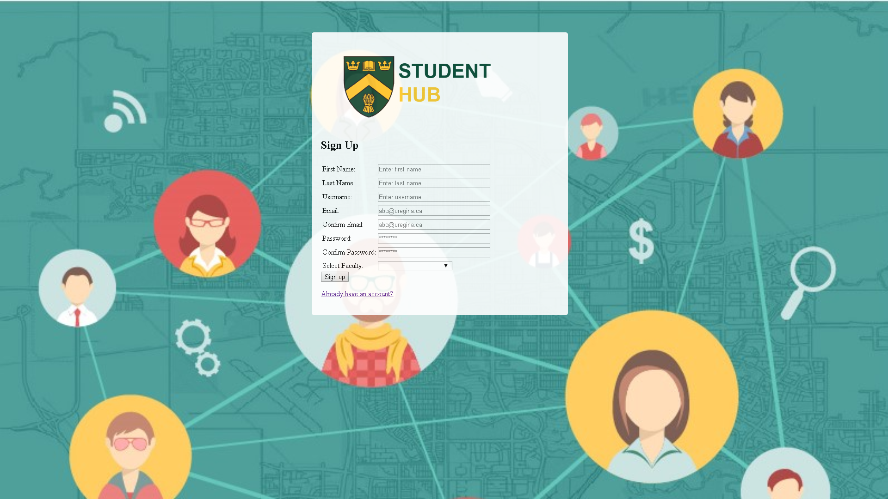

Pictures
Login Page
Sign up page
Our Logo with UofR Crest

Slide 6
Pictures
Login Page
Sign up page
Our Logo with UofR Crest

Slide 7

Website Demo
STUDENT
HUB

Slide 8
Discussing MVP-2
What do we like?
Tinkering
MVP-1 Vs MVP-2
Design and features
Nested comment-reply system
Voting system
better design
Notifications
Edit Profile
hashtag system for specific conversations
Search
Better Design than MVP-1
Post threads
Profile Page
Events

Slide 9
DISCUSSING MVP-2
Was our team successful in mapping out our envisioned MVP-2?
?
Highlights and Better-iffs
</
Code
-80%
-This project is to connect UofR students
-Better knowledge of AJAX and JSON
-code is clean except we have used internal css instead of external.

Slide 10
Future MVP
1
2
Nested Comment section
Better Website Design
3
4
Edit Profile
Picture Uploads

Slide 11

KANBAN
New Meetings
Blaugranes
updated FRD, added features, completed user stories.
Codes

Slide 12




Meet Our Team
Programmer
Programmer
Design and Architecture
Document and Github handler
Gift
Kyle
Anirudh
Louise
Programming the website, scheduling meeting dates
Programming the website and MVC structure
Designing the layout and structure of the website and presentation slides.
Updating project repository and kanban. Writing FRD document for the project.

Slide 13
Project Timeline
</>
FIRST MEETING
DETAILED DESCRIPTION
PROGRAMMING
Choosing Project
Discussing features and layout of the website.
For MVP-1, Website was developed for demo and give people an idea about the website.

Slide 14
Project Timeline
CHANGES
POST MVP-1
FINAL PROJECT
Changes were made in project vision and layout of the website.
Shrinked the scope of website, New layouts were discussed, profile page developed, comment system developed.
Working website approved by all the members of the team

Slide 15
Group Reflection
•How did you feel about this Project? What did you like about it? What did you dislike?
-We feel perplexed
-It was a good learning experience
•What did you learn about yourself as you collaborated and worked through this Project?
-We learned about individual skills
-Never be too ambitious
•How will you use what you have learned going forward?
-Each team member will focus on specific tasks for accuracy and efficiency
-We can use project management in future projects
•What “stuff & things” related to this Project would you want help with?-could have been better?
-Programming

Slide 16

Thank You
For your attention!

